Slide 1
PRINCIPALS AND CAREER TEACHERS CONSULTATION 2021
PROFESSOR PAL AHLUWALIA
VICE-CHANCELLOR AND PRESIDENT
The University of the South Pacific
November 2021
Notes:
VC

Slide 2
USP VISION AND MISSION
VISION
MISSION
PRIORITY AREAS
VISION To shape Pacific futures by empowering students, staff and alumni to become inspirational agents of positive change leading to innovative, cohesive, resilient and sustainable communities | MISSION To influence Pacific Islanders through the pursuit of excellence in knowledge by providing world-class education and research that improves the lives of individuals and communities
PRORITY AREAS The Vision and Mission is supported by following Priority Areas: Education Research, Innovation and Partnerships Regional Campuses & Global Engagements Regional Cooperation Through the CROP Network Governance and Intelligent use of Resources

Slide 3
OUR VALUES
Commitment and loyalty of staff and students to the institution and the Pacific region
Commitment to academic freedom and highest standards of governance, leadership, integrity, transparency and ethical behavior
Highest standards of creativity, innovation, teamwork and flexibility in the pursuit of excellence
Investments in staff, rewarding staff excellence and empowerment of all USP teams
Respect for distinctiveness and diversity in our Pacific heritage and its development, preservation and dissemination
Commitment to regional cooperation and integration
Positive, safe and inclusive environments
Support for flexible learners in all locations for success in work, life and citizenship
Protection and nurturing of the environment
Strong relationships to guide engagement with national governments, Pacific communities, and development partners.

Slide 4
ACADEMIC EXCELLENCE
Extensive knowledge of and relevant skills in a particular discipline or professional area
Capacity for critical thinking and independent self-directed, life-long learning
Advanced information and communication technology knowledge and skills
Research skills

Slide 5


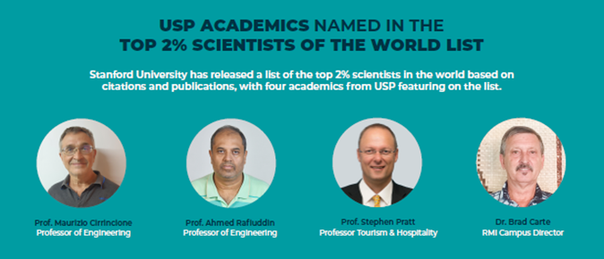
ACADEMIC EXCELLENCE
USP achieves international recognition in prestigious Times Higher Education (THE) World University Rankings and is ranked amongst the TOP 10% of Universities in the World
USP ranked 11th in Crisis Management amongst the TOP 100 Universities in the World Universities Real Impact Ranking System
Stanford University names 4 USP academics in its TOP 2% Scientists of the World List

Slide 6
USP’S REGISTRATION WITH NATIONAL AGENCIES
FIJI Higher Education Commission USP’s Initial Registration with FHEC was acquired in 2013 for 5 years till 2017 USP was given an extension of 2 years on its initial registration until May 2020 | SAMOA Qualifications Authority USP’s Initial Registration with SQA was in 2014 for a year Its is an Annual Registration process. The current registration is up to April 2021
VANUATU Qualifications Authority USP’s Initial Registration with VQA was in 2017 for 5 years till 2022 | TONGA National Qualifications Authority Board USP’s Initial Registration with TNQAB was in 2014 for 4 years till 2018 With on-going restructuring of TNQAB’s processes, an extension was given for year 2019 and USP’s registration was renewed in 2020.
Notes:
VC

Slide 7
FINANCIAL AID
& SCHOLARSHIPS
USP Assistance | USP provides scholarships and Financial Assistance through the Student Bursary Scheme to students at undergrad and postgrad level
Scholarships by USP Member Countries | The governments of USP member countries sponsor their own citizens for undergraduate and postgraduate studies at USP USP works in collaboration with member country Government in monitoring their local scholarships recipients
Assistance from Development Partners | USP works with its development partners and partner institutions for students and staff to undertake scholarships at any of its campuses around the region AUSAid, NZAid and Taiwan-ROC also offer scholarships for USP These scholarships are offered outside USP and normally be taken at the host country: - 2021 Korea Global Scholarship - 2021 Taiwan Scholarships

Slide 8
NATIONAL TOPPERS SCHEME AND TELS
There are currently 16,611 students under TELS at the cost of $93m and 2525 under National Toppers Scheme
For 2021 academic year, the following allocations have been made by the Fiji Government:
National Toppers Scheme $46.4m
Tuition Fee under TELS $66.8m
Allowances under TELS $46.7m

Slide 9
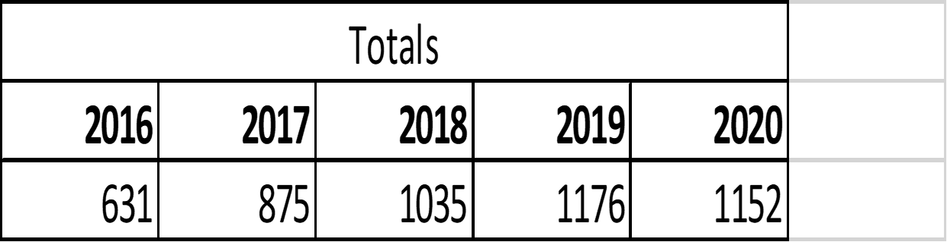
TREND – TELS & TOPPERS

Slide 10
UNDERGRADUATE SCHOLARSHIPS
Pacific Academic Excellence Awards
Promotes and rewards merit-based academic excellence to benefit students from the region
Offered to students from each member country with the highest score in either Form 7 Exams or Senate-recognised national equivalence
Also offered to two students with highest scores in Foundation Studies - one each from Social Science and Science.
Shrikisun Balgovind Scholarship
Provides scholarships to two deserving persons from the two major ethnic communities in Fiji
Regional Disability Scholarship
Promote Disability Inclusion in tertiary education and empower persons with a disability to attain tertiary qualification
Offered to students with a disability from any USP member country

Slide 11
STUDY OPPORTUNITIES
SCHOOL OF LAW AND SOCIAL SCIENCES (SOLASS) | SCHOOL OF BUSINESS AND MANAGEMENT (SBM) | SCHOOL OF AGRICULTURE, GEOGRAPHY, ENVIRONMENT, OCEAN AND NATURAL SCIENCES (SAGEONS)
Discipline of Government Development and International Affairs Discipline of Social Sciences Discipline of Law | Discipline of Tourism & Hospitality Management Discipline of Management and Public Administration Discipline of Land Management & Development Graduate School of Business | Discipline of Agriculture and Food Technology Discipline of Biological & Chemical Sciences Discipline of Geography, Earth Science and Environment Discipline of Marine Studies
CERTIFICATES
DIPLOMAS
BACHELOR’S DEGREE
PROFESSIONAL CERTIFICATES & DIPLOMAS
POSTGRADUATE PROGS
MASTER’S DEGREES
DOCTOR OF PHILOSOPHY

Slide 12
STUDY OPPORTUNITIES
SCHOOL OF PACIFIC ARTS, COMMUNICATION AND EDUCATION (SPACE) | SCHOOL OF ACCOUNTING, FINANCE AND ECONOMICS (SAFE) | SCHOOL OF INFORMATION TECHNOLOGY, ENGINEERING, MATHEMATICS AND PHYSICS (STEMP)
Discipline of Education Discipline of Communication Oceania Centre for Arts, Culture & Pacific Studies | Discipline of Accounting & Finance Discipline of Economics | Discipline of Civil Engineering Discipline of Computer Sciences and Information Systems Discipline of Electrical and Electronics Engineering Discipline of Mathematics and Statistics Discipline of Mechanical Engineering Discipline of Physics
CERTIFICATES
DIPLOMAS
BACHELOR’S DEGREE
PROFESSIONAL CERTIFICATES & DIPLOMAS
POSTGRADUATE PROGS
MASTER’S DEGREES
DOCTOR OF PHILOSOPHY

Slide 13
STUDY OPPORTUNITIES
PACIFIC CENTRE FOR ENVIRONMENT & SUSTAINABLE DEVELOPMENT (PaCE-SD) | Postgraduate Diploma in Climate Change Masters in Climate Change by Research PhD in Climate Change
PACIFIC TECHNICAL & FURTHER EDUCATION | Preliminary studies Foundation studies Skill Based programmes

Slide 14
CONCLUSION
Thank you for your attendance today
The USP Handbook and Calendar provides details of all our programmes and courses - available on the USP website
2022 Prospectus will be sent directly to your schools

Slide 15
THANK YOU
Questions & Discussion

